Slide 1
E.V.S QUIZ FROM CHAPTER 13- A SHELTER SO HIGH.
SO LET ‘ S START THE QUIZ

Slide 2
1. A STATE / UNION TERROTERY IN WHICH VERY LITTLE RAINFALL HAPPENS –
A. JAMMU AND KASHMIR
B. LADAKH
C. HIMACHAL PRADESH
D. PUNJAB

Slide 3
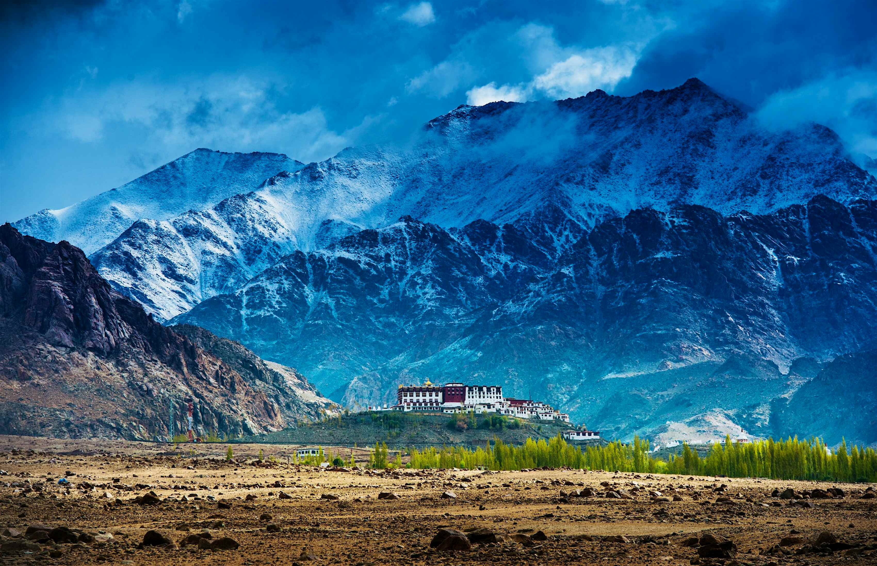
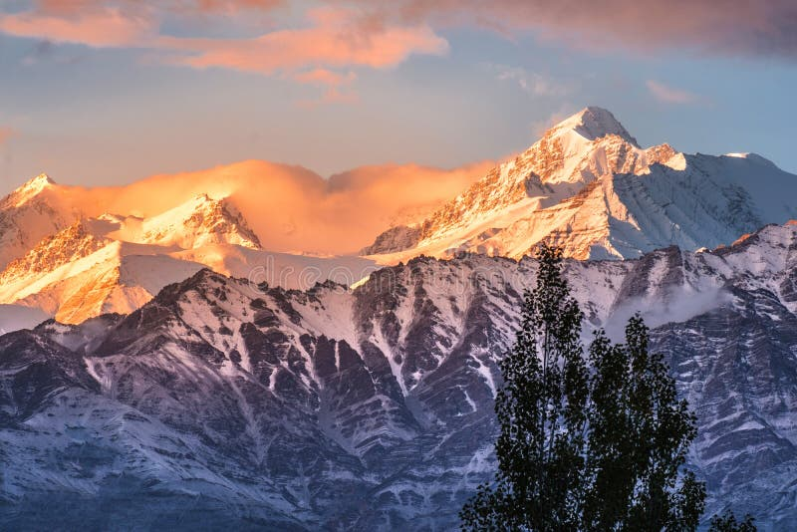
ANS – B. LADAKH

Slide 4
2. In the roof top of tashi ‘ s house , what things were laid ?
A. red chillies, orange pumpkins , orange tomatoes b. golden yellow corns , purple pumpkins , green chillies c. red chillies , orange pumpkins , golden yellow corns d. golden yellow carrot , green raw chillies , orange pumpkins

Slide 5
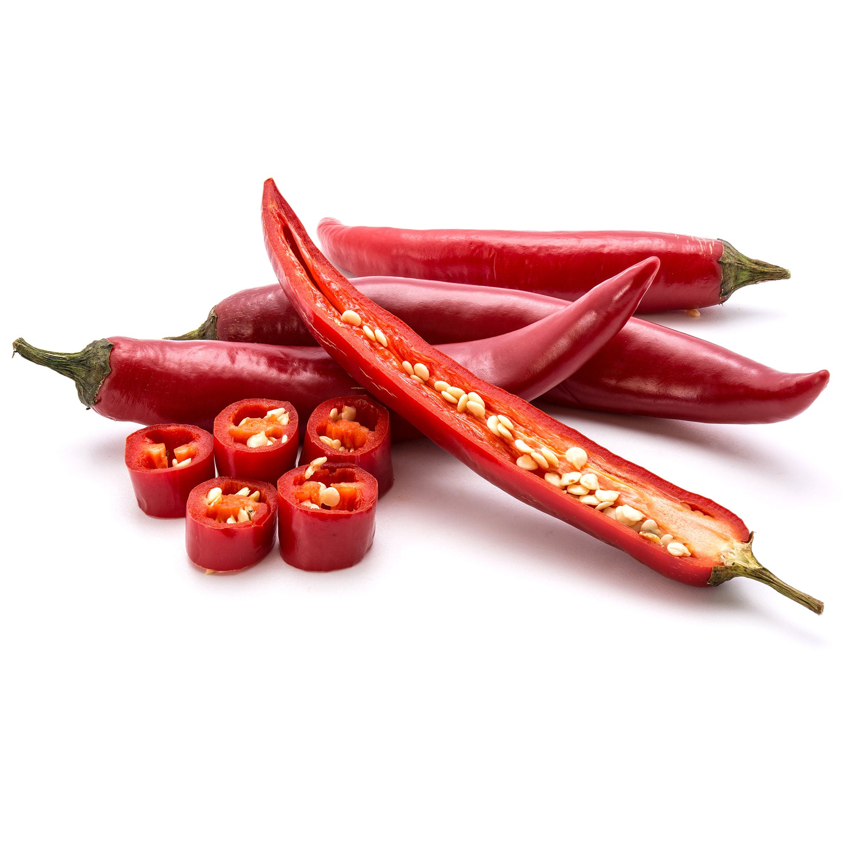
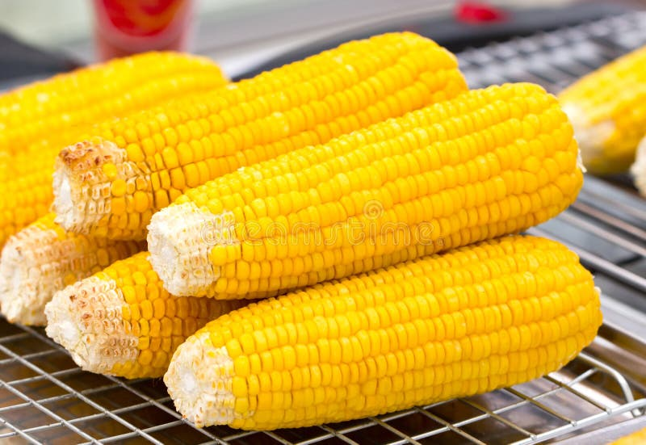
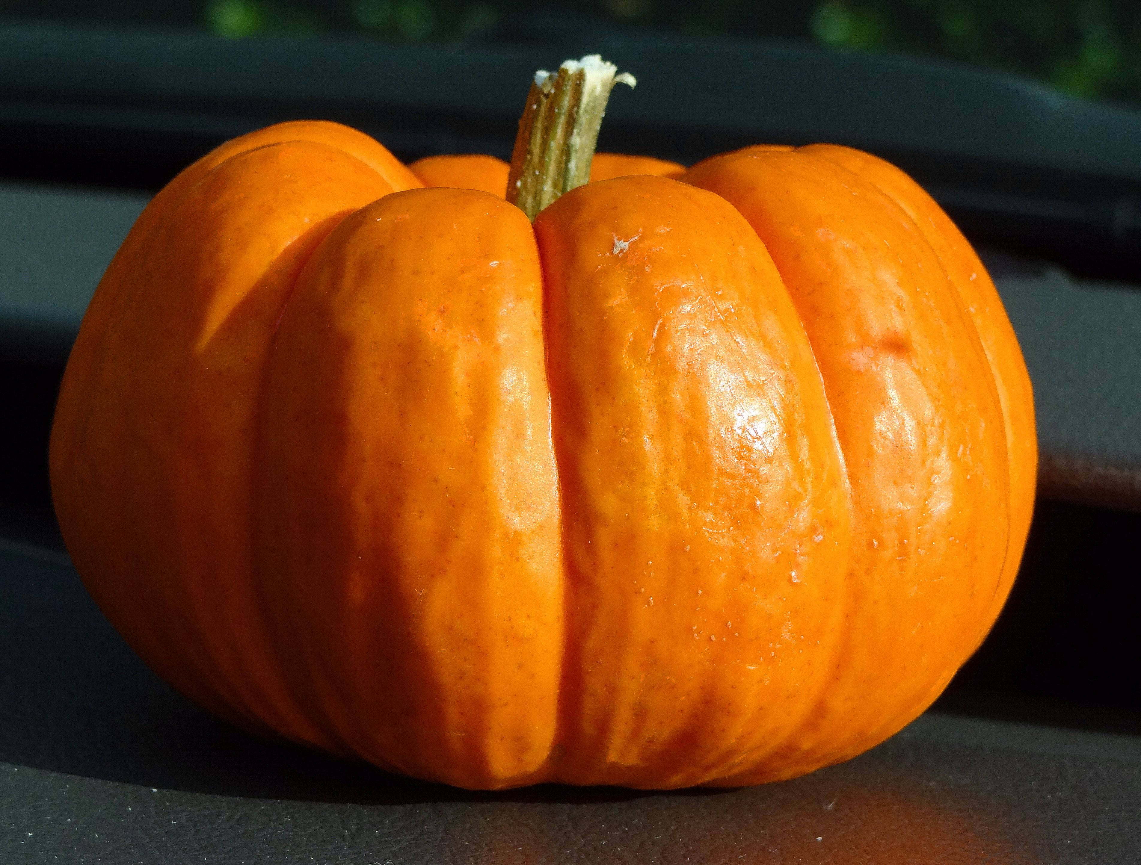
Ans – c. red chillies , orange pumpkins , golden yellow corns

Slide 6
Name the foods that are sold in the Ladakhi street shops/bakery.
A. momos b. noodles c. oranges d. roti

Slide 7
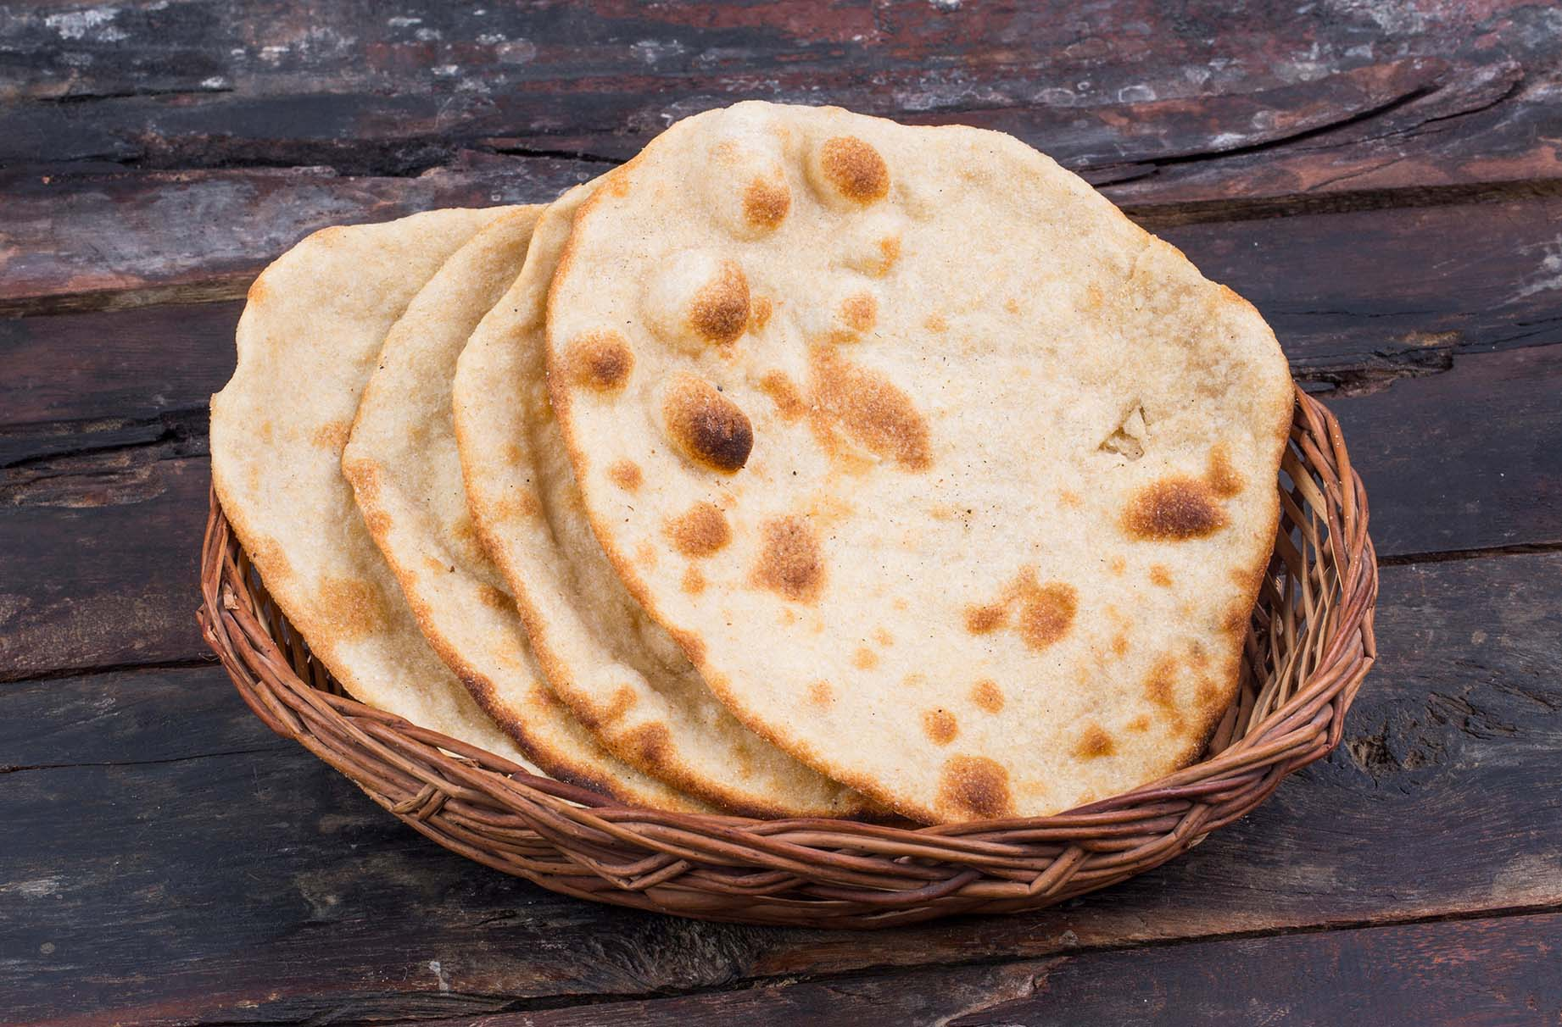
Ans – d. roti

Slide 8
4. Name the common traditional dress of Ladakh for both men and women.
A. goncha b. sulma c. skerag d. burgundy

Slide 9
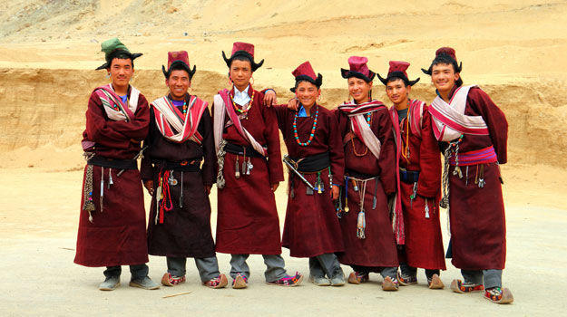
Ans – c. skerag

Slide 10
5. What is the famous river of Srinagar ? a. Jhelum river b. vinod raina river c. Yamuna river d. indus river

Slide 11
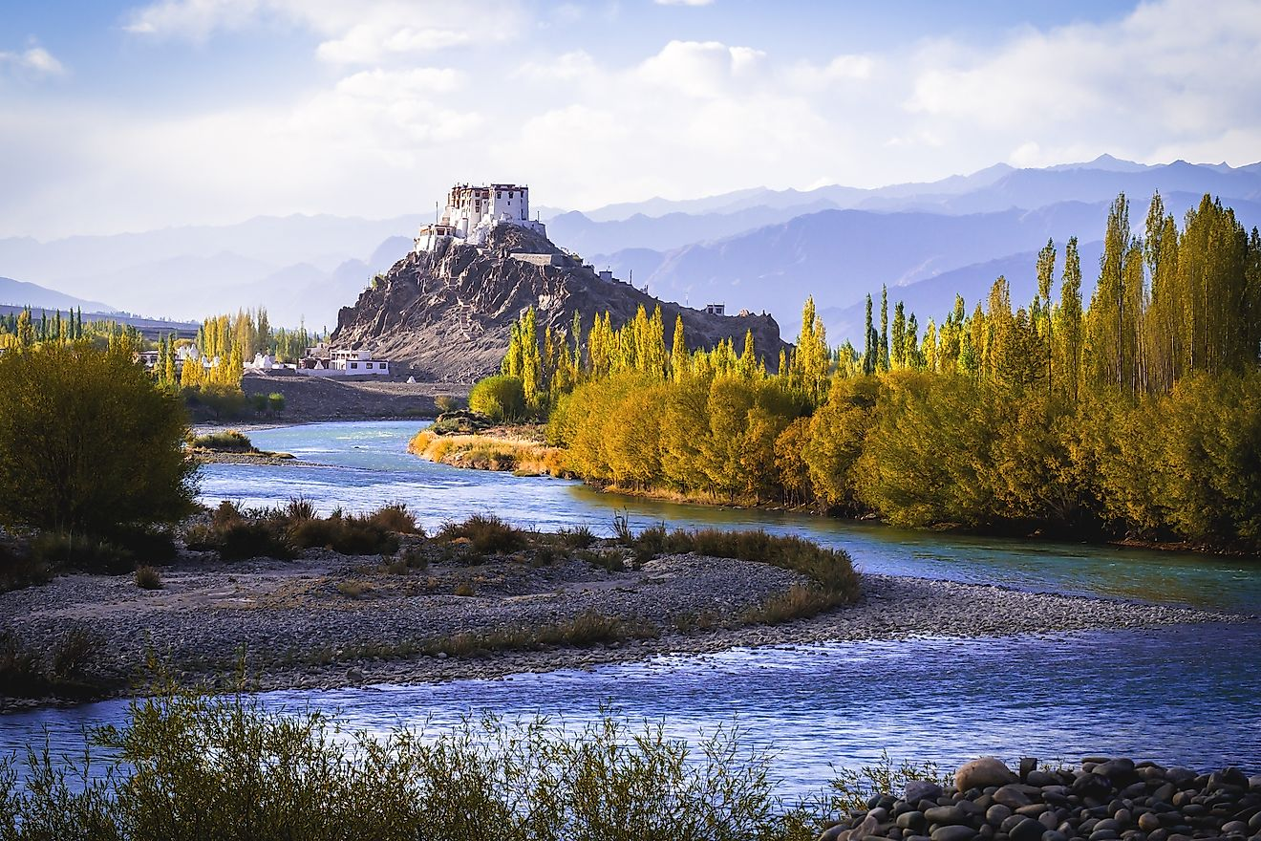
Ans –d. indus river

Slide 12
6. What the people of Srinagar call the boats ? a. Tonga b. donga c. rebo d. changpa

Slide 13
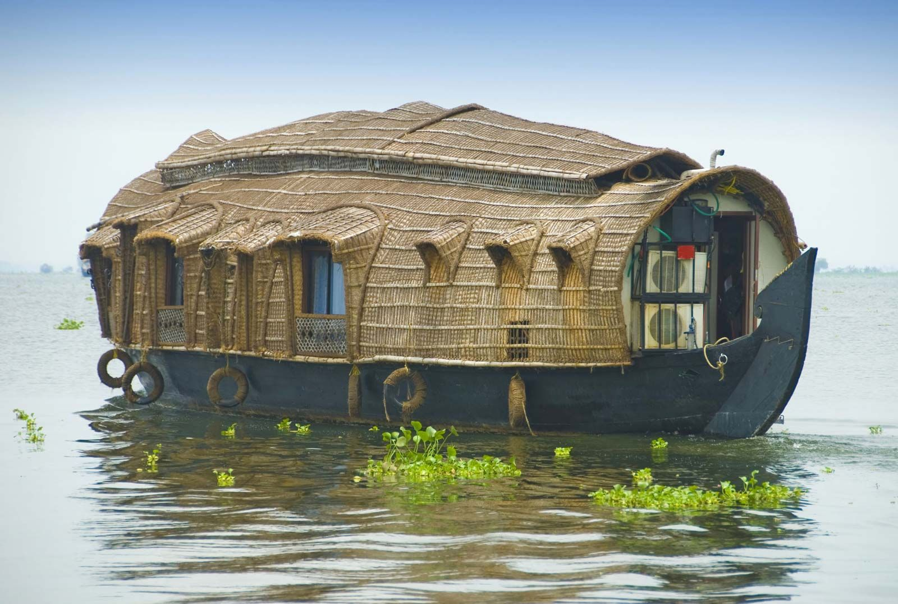
Ans – b. donga

Slide 14
7. How many foot the ground is dug ? a. 1 b.2 c.4 d.3

Slide 15
Ans – b. 2

Slide 16
8. How many days it take to make one pashmina shawl ? a. 5 days 15 hours b. 6 days 10 hours c. 3 days 9 hours d. 4 days 10 hours

Slide 17
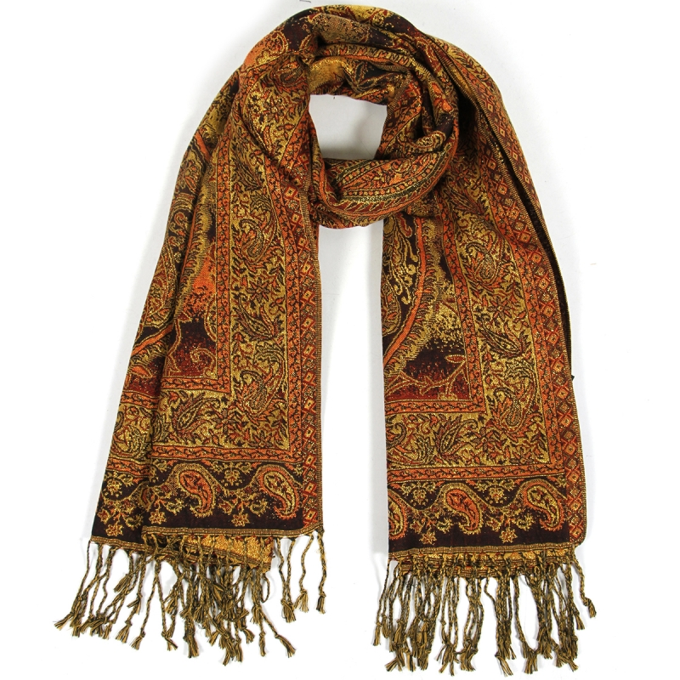
Ans – d. 4 days 10 hour

Slide 18

Thank you.

